Slide 1
文檔
2019-04-13(六)

Slide 2
接收手機端需求
1.Client首先會接收到request from android
2.這個request包括
寄件地址+收件地址(以經緯度型態表示)
貨車抵達收件人地址的time interval挑選
訂貨單號跟車子的關係(一對一 V.S 多對一)
3.Client會把傳入的source geo-position, desitnation geo-position轉成Sender Address edgeID, Receiver Address edgeID, Sender gui-position and Receiver gui-position
4.Client也會對現況所有車子做getPosition()與getRoadID(), 取得每一台車的gui-position與目前位置edgeID

Slide 3
計算現有車輛與Sender之間距離
1.剛剛把所有的車輛資訊，提取each vehicle gui-posion(假如10台車)，那計算這10台車(car1,car2,…car3)與sender gui-position之間的距離
2.利用getDistance2D(self, x1, y1, x2, y2, isGeo=False, isDriving=False) getDistance2D(double, double, double, double, boolean, boolean) -> double
3. distance5=min{distance1, distance2,…distance10}
4.那就把car5認定成配送車

Slide 4
動態路徑規劃
1.把剛才挑選的car5設定為派遣車輛，取得car5的gui-position(x,y座標)與car5_roadID(也就是car5_edgID)
2.給startEdge: car5_edgID, endEdge:sender_address_edgeID
3.接著是動態規畫路徑，目前還沒查到ws的相關用法，所以用TraCI(python)代替表示:
traci.route.add("trip", ["startEdge", "endEdge"])
traci.vehicle.add(“newVeh”, “trip”, typeID=“reroutingType”) //增加這台車
4.關鍵在於如何用scripts與起始終點邊，規劃出一條route，，比較接近的是ws.RouteAdd(String routeID, List<String> edges)

Slide 5
前往sender address
1.從car5目前所在地，前往sender address時，要停下來
2.因此用到該函數Vehicle_setStop
3.public void Vehicle_setStop(String vehID, String edgeID, double pos, byte laneIndex, int duration, SumoStopFlags stopType)
4. Class SumoStopFlags //http://sumo.sourceforge.net/javadoc/traas/de/tudresden/ws/container/SumoStopFlags.html
5.注意SumoStopFlags有很多parameters，例如isStopped, setStoppedvalue, isContainerTriggered, setIsContainerStop
6.當車子到sender address時，要做isIsContainerStop()的參數調整，還有load container的調整
7.SumoStopFlags能用的method like notify(),wait()

Slide 6
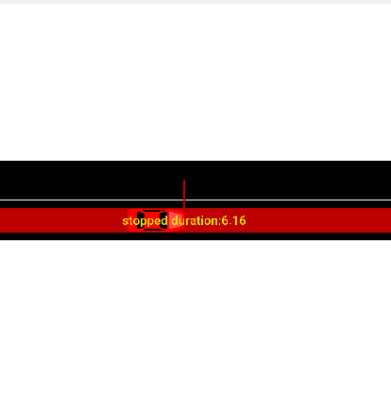
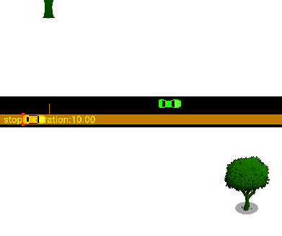

Slide 7
從收件者到寄件者位置
1.當再車子在sender停下來時，會計算stop duration，例如停10秒
2.再10結束後，應當安排從寄件者到收件者路徑規劃，
traci.route.add("trip_StoR", [“senderEdge", “ReciverEdge"])
traci.vehicle.add(“newVeh”, “trip_StoR”, typeID=“reroutingType”)
setContainerStop()
3. setContainerStop(self, vehID, stopID, duration=-1073741824.0, until=-1073741824.0, flags=0)
setContainerStop(string, string, double, double, integer) -> None Adds or modifies a container stop with the given parameters.
The duration and the until attribute are in seconds.
4.當arrive receiver address時，要停留一陣子，並且用SumoStopFlags的method like notify()外界

Slide 8
Geo-postion to gui-position
System.out.println(conn.do_job_get(Simulation.convertGeo(3414.680, 5591.166, false ))); // 120.22115148153793,22.985924116857188
System.out.println(conn.do_job_get(Simulation.convertGeo(120.216228, 22.987473, true ))); // 2912.904071369441,5772.349525868427
After
Before
Lon:120.216228
Lat:22.987473
用clipboard貼上的
X:2912.41
Y:5772.38
X:2912.904071369441
Y:5772.349525868427
誤差
X_before:2912.41
X_after:2912.904071369441
Y_before:5772.38
Y_after:Y:5772.349525868427

Slide 9
Gui-postion to Geo-position
Before
After
X:3414.680
Y:5591.166
用clipboard貼上的
lon:120.221146
lat:22.985924
Lon:120.22115148153793
Lat:22.985924116857188
誤差
Lon(前 v.s 後)
120.221146
120.22115148153793
Lat(前 v.s 後)
22.985924
22.985924116857188

Slide 10
getDistance2D
getDistance2D(double x1, double y1, double x2, double y2, boolean isGeo, boolean isDriving)
isDrving=true 2362.2630483917073 [m]
isDrving=false
2284.551904816347[m]
double startPosX = 4061.28;
double startPosY = 5207.22;
double endPosX = 2052.75;
double endPosY = 6295.79;
double startPosX = 4061.28;
double startPosY = 5207.22;
double endPosX = 2052.75;
double endPosY = 6295.79;

Slide 11
getDistanceRoad
getDistanceRoad(String edgeID1, double pos1, String edgeID2, double pos2, boolean isDriving)
(isDrving=true & isGeo=false) 2268.47 [m]
(isDrving=false & isGeo=false)
2204.4200443880927 [m]
String startEdgeId = "307244665#2";
String endEdgeId = "496332196#1";
double pos1 = 0.0;
double pos2 = 0.0;
String startEdgeId = "307244665#2";
String endEdgeId = "496332196#1";
double pos1 = 0.0;
double pos2 = 0.0;

Slide 12
findRoute
System.out.println(conn.do_job_get(
Simulation.findRoute(fromEdge, toEdge, vType, depart, routingMode)));
error
參數
String fromEdge = "307244665#2";
String toEdge = "496332196#1";
String vType = "routeByDistance";
double depart = 40;
int routingMode = 0;s
java.lang.IllegalStateException: Error reading byte, invalid list position specified for reading: 706
at de.uniluebeck.itm.tcpip.Storage.readByte(Storage.java:141)
at de.uniluebeck.itm.tcpip.Storage.readString(Storage.java:502)
at de.uniluebeck.itm.tcpip.Storage.readStringASCII(Storage.java:462)
at de.tudresden.sumo.util.CommandProcessor.readStage(CommandProcessor.java:860)
at de.tudresden.sumo.util.CommandProcessor.do_job_get(CommandProcessor.java:762)
at it.polito.appeal.traci.SumoTraciConnection.do_job_get(SumoTraciConnection.java:376)
at Main.main(Main.java:135)

Slide 13
getDistance2D
System.out.println(conn.do_job_get (Simulation.getDistance2D(startLon, startLat, endLon, endLat, true, false)));
參數
error
double startLon = 120.227524;
double startLat = 22.982570;
double endLon = 120.207748;
double endLat = 22.992048;
SUMO error for command 171: Unknown position format used for distance request //java-console
----------------------------------------------
Error: Answered with error to command 0xab: Unknown position format used for distance request
Error: tcpip::Socket::recvAndCheck @ recv: peer shutdown
Quitting (on error). //gui-console

Slide 14
convertRoad
System.out.println(conn.do_job_get
(Simulation.convertRoad(2466.06, 7243.26, false, "ignoring")));
參數
error
double x = 2466.06;
Double y = 7243.26;
Boolean isGeo =false;
String vClass = “ignoring”;
SUMO error for command 171: Position conversion requires a source position and a position type as parameter.//java-console
-------------------------------------------------------------
Error: Answered with error to command 0xab: Position conversion requires a source position and a position type as parameter. //sumo-gui

Slide 15
convertRoad
System.out.println(conn.do_job_get
(Simulation.convertRoad(2466.06, 7243.26, false, "ignoring")));
參數
double x = 2466.06;
Double y = 7243.26;
Boolean isGeo =false;
String vClass = “ignoring”;
:3078271785_0, 4.018174942844767, 0
String edgeID=“3078271785_0”
double position:
int laneIndex:

Slide 16
convertRoad
System.out.println(conn.do_job_get(Simulation.convertRoad(120.227524, 22.982570, true, "ignoring")));
參數
double lon = 120.227524;
double lat = 22.982570;
Boolean isGeo =true;
String vClass = “ignoring”;
120.22752444040958,
22.982570512551675
307244665#2, 3.6605540809902037, 0
String edgeID=“307244665#2”
double position: 3.6605540809902037
int laneIndex: 0

Slide 17
Map Generation
$polyconvert --net-file map_edited.net.xml --osm-files map2.osm --type-file typemap.xml --output tainan.poly.xml
$ python randomTrips.py --net-file map_edited.net.xml --end 10 -l --output map.trip.xml
$ python randomTrips.py -n map_edited.net.xml –r map.rou.xml -e 10 –l

Slide 18
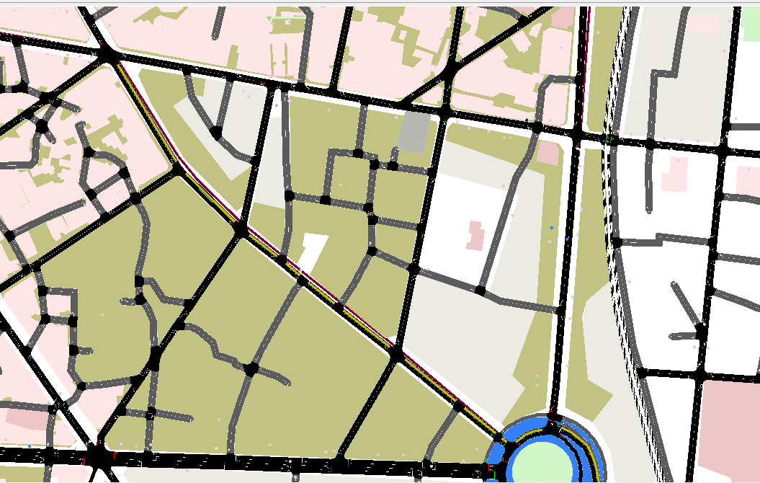

Slide 19
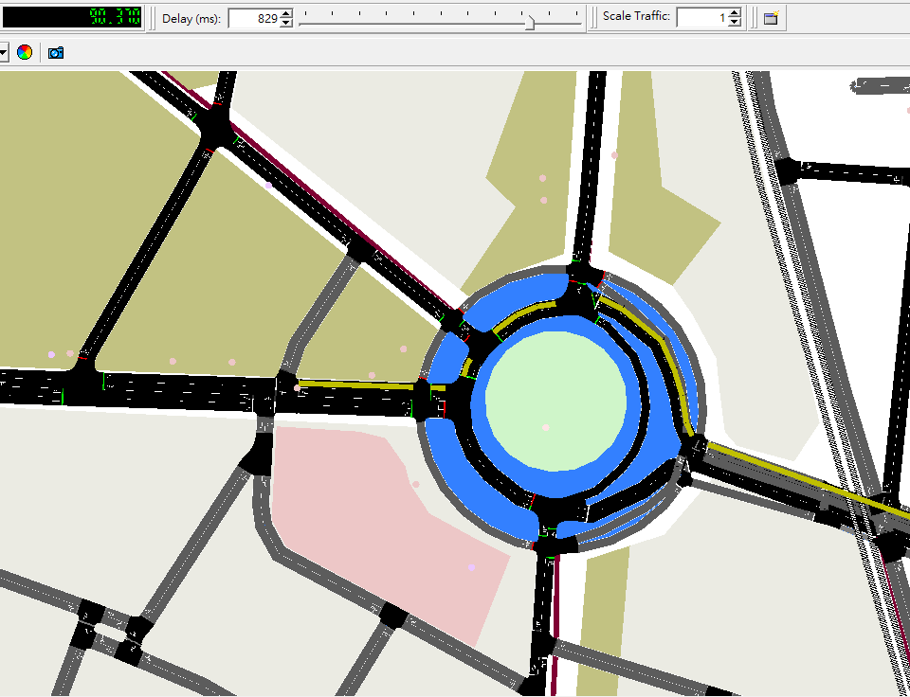

Slide 20
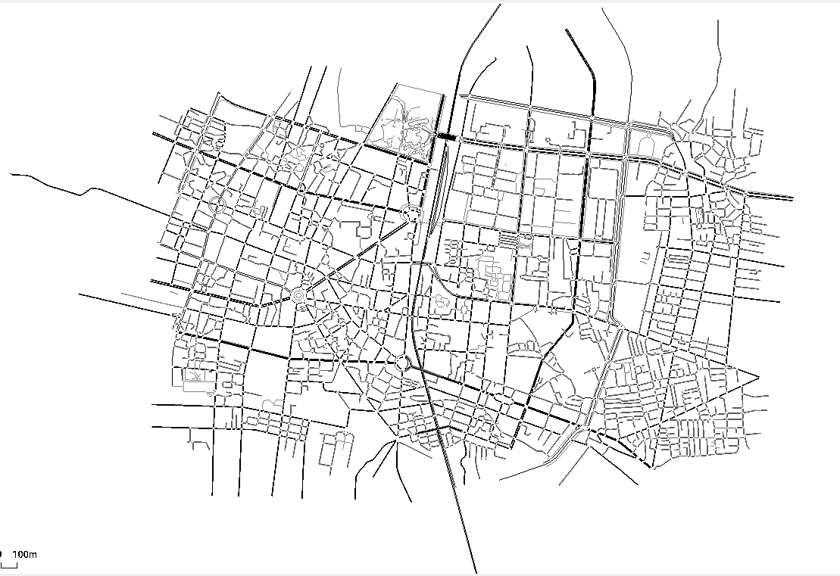
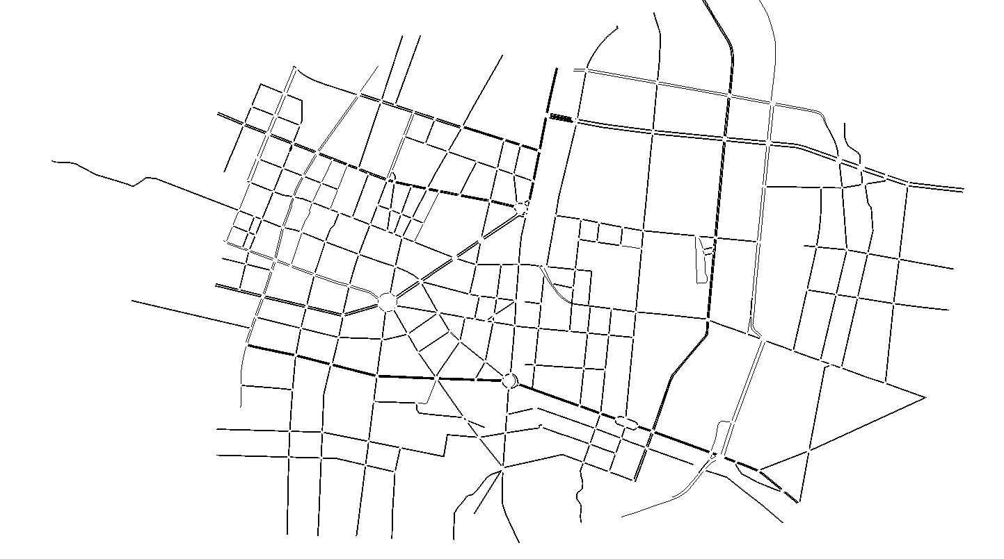

Slide 21
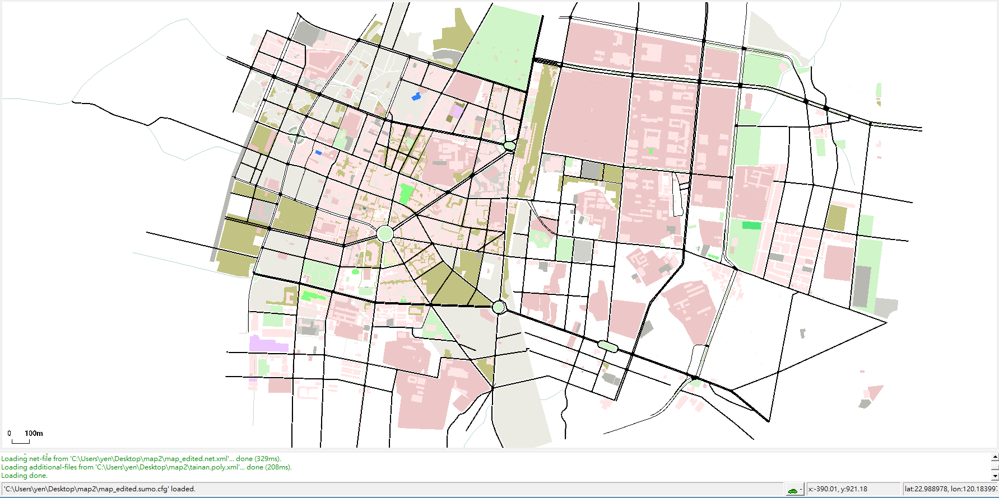

Slide 22
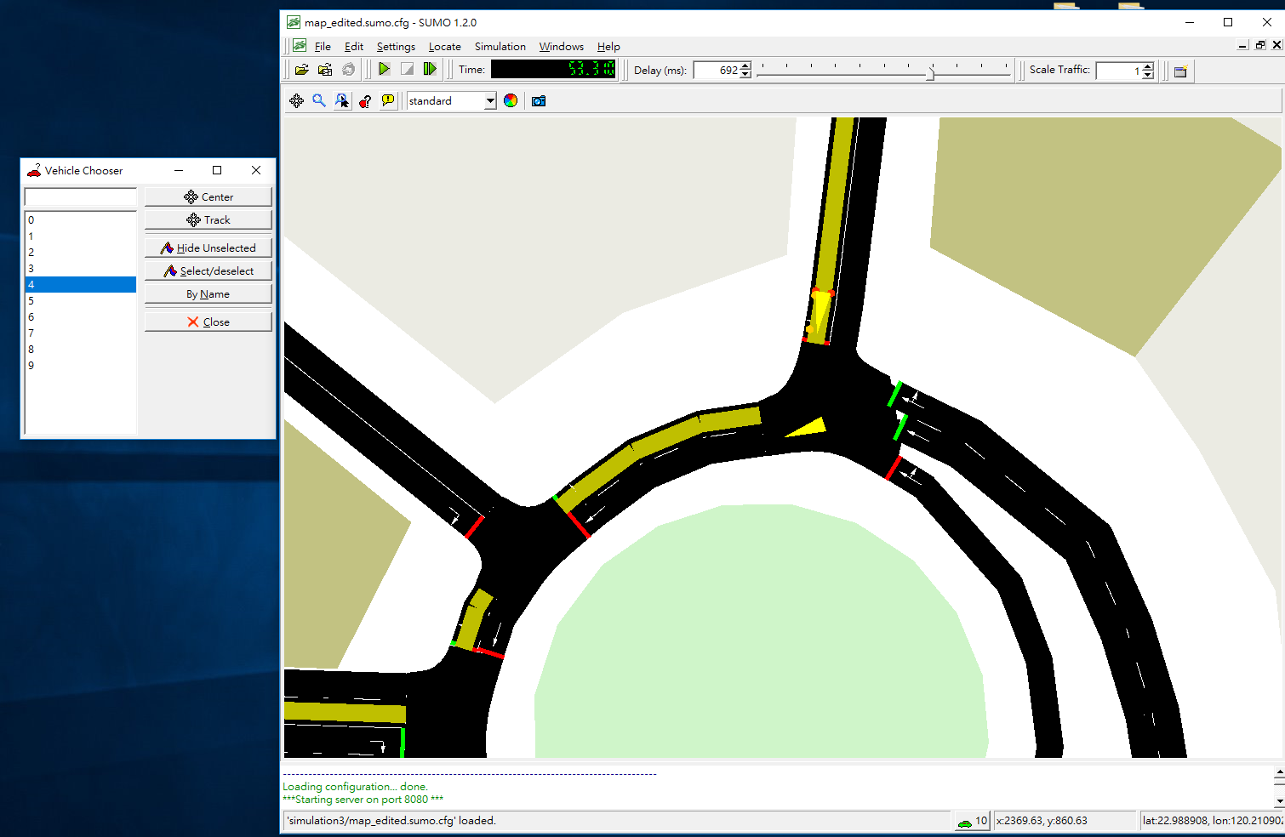

Slide 23
Progress report-
converRoad issue fixed
findRoute issue fixed
changeRoute demo
Date:2019-04-29(一)

Slide 24
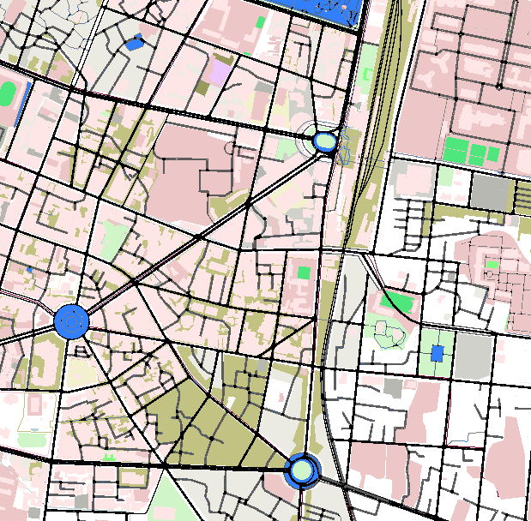
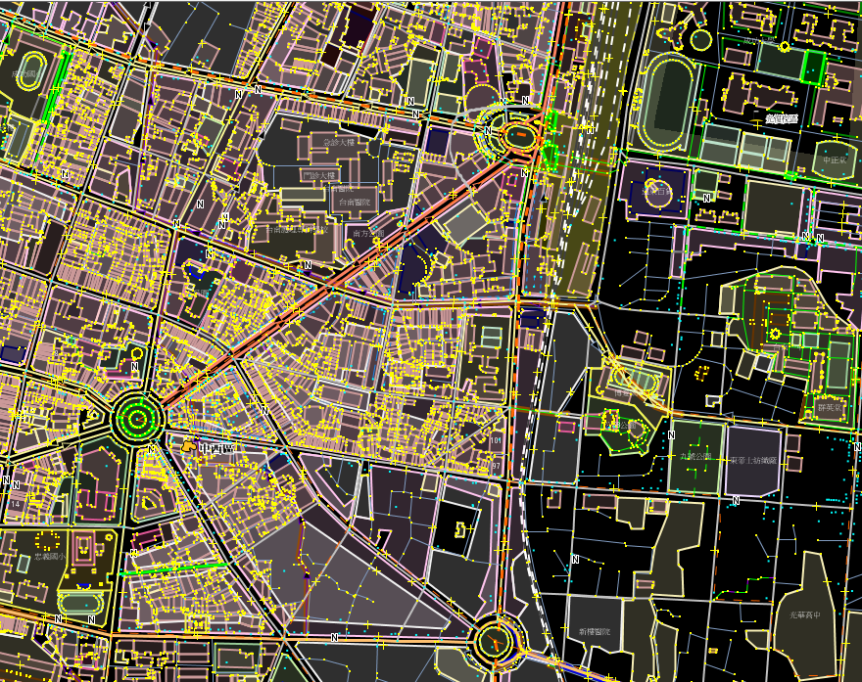

Slide 25
convertRoad
------------convert2D part-------------
convert2D('496249899#1', 0.6669427384818771, (byte)0, false)
Result:2467.9570221295635,6810.675393989347
------------convertRoad part------------
convertRoad(2467.9570221295635, 6810.675393989347 , false, "ignoring")
Result:496249899#1, 0.6669427384818679, 0

Slide 26
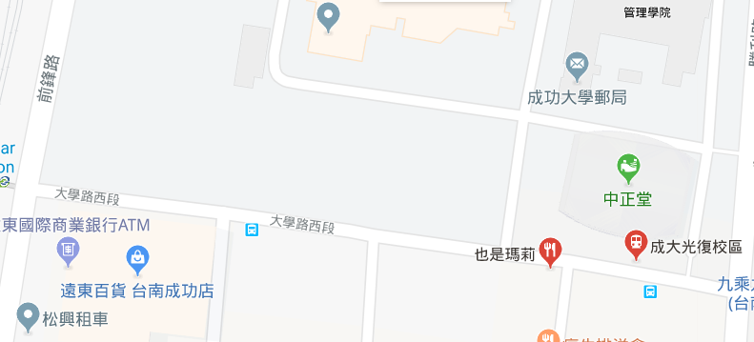
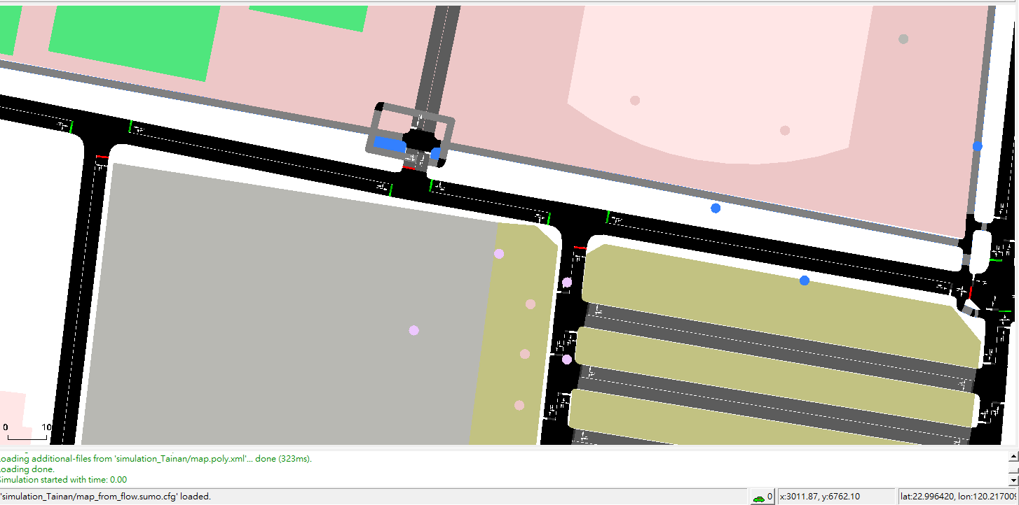
Sender address
(X,Y)=(2989.02, 6765.41)
(lon,lat)=(120.216786, 22.996446)
LaneID:”-537706053#2_0”
edgeID:”-537706053#2”

Slide 27
convert2D('-537706053#2', 0.0, (byte)0, false)
3013.7,6761.51
convertRoad(2989.02, 6765.41, false, 'ignoring'))
-537706053#2, 24.98140320859787, 0

Slide 28
convertRoad(1387, 6497 , false, "ignoring")
<edge id=":1235793433_4" function="internal">
<lane id=":1235793433_4_0" index="0" disallow="tram rail_urban rail rail_electric ship" speed="13.89" length="11.04" shape="1388.94,6495.41
1391.56,6506.13"/>
</edge>
<edge id=":1235793433_5" function="internal">
<lane id=":1235793433_5_0" index="0" disallow="tram rail_urban rail rail_electric ship" speed="3.65" length="2.34" shape="1388.94,6495.41
1388.44,6496.76
1387.76,6497.34"/>
</edge>
<edge id=":1235793433_11" function="internal">
<lane id=":1235793433_11_0" index="0" disallow="tram rail_urban rail rail_electric ship" speed="3.65" length="2.34" shape="1387.76,6497.34
1386.89,6497.13
1385.83,6496.15"/>
</edge>

Slide 29
The precision problem of convertRoad

Slide 30
A solution to the pinpoint problem of convertRoad

Slide 31
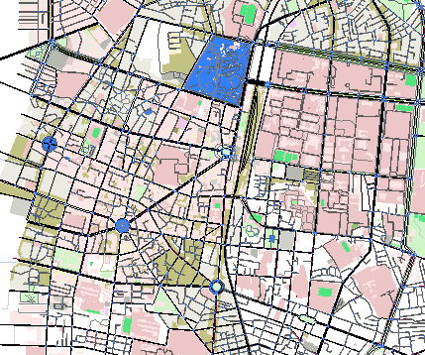
Remove the trivial lanes and make the map simple

Slide 32
findRoute
SumoStage stage = (SumoStage) conn.do_job_get(Simulation.findRoute(fromEdge, toEdge, vType, depart, routingMode));
String fromEdge = "307244665#4";
String toEdge = "31794904#2";
String vType = "routeByDistance";
double depart = 60.0;
int routingMode = 0;
newRoute:
[307244665#4, -298597678#5, -298597678#4, -298597678#3, -298597678#2, -298597678#1, -298597678#0, -298597679#4, -298597679#3, -298597679#2, -298597679#1, -298597679#0, -413131917, -186109367#5, -186109367#4, -186109367#3, -186109367#2, -186109367#1, -186109367#0, -316267745#1, -316267745#0, 667223560#0, 667223560#1, 41389171, -496261701#2, -496261701#1, -496261701#0, -41389179, 413128683, 413128684, 41389178, 160253728, 107538178#0, 31794904#0, 31794904#1, 31794904#2]

Slide 33
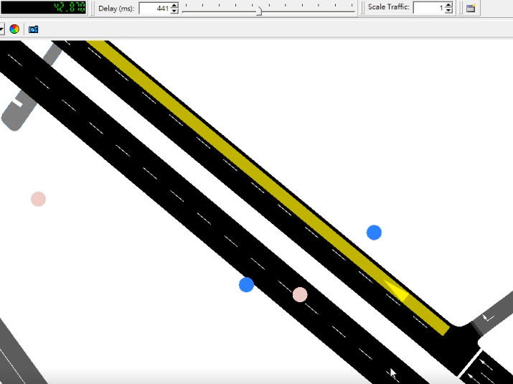
Vehicle ”flow0.0” starts at 40s

Slide 34
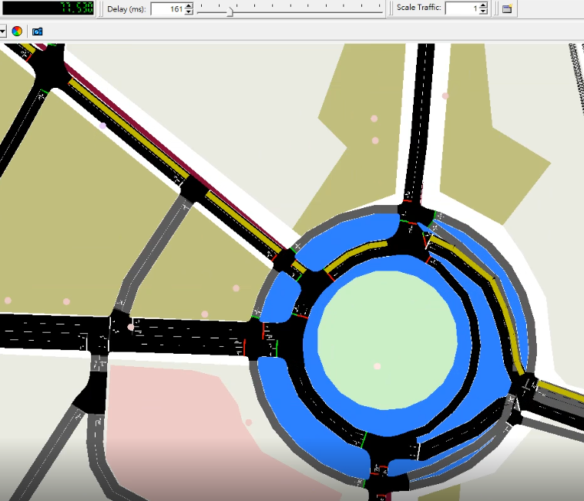
Follow default route from 40s-90s and re-built the new route when the sender sends the request at 90s
If(time==90.0){
String senderEdgeID ="160253722#1";
conn.do_job_set(Vehicle.changeTarget("flow0.0", senderEdgeID));
}

Slide 35
Follow default route from 40s-90s and re-built the new route when the sender sends the request at 90s
If(time==90.0){
String senderEdgeID ="160253722#1";
conn.do_job_set(Vehicle.changeTarget("flow0.0", senderEdgeID));
}

Slide 36
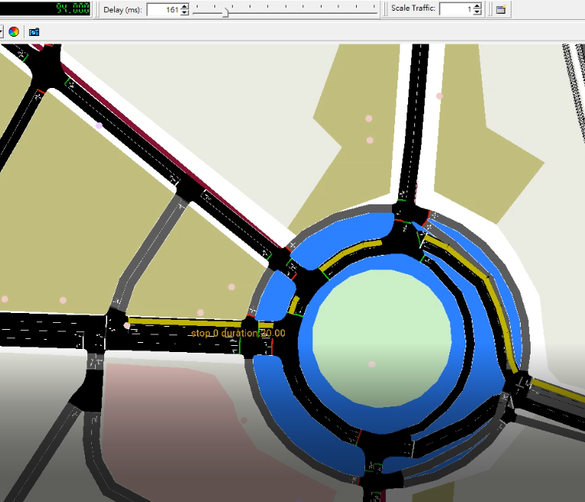
77.530s
94.000
conn.do_job_set(Vehicle.changeTarget("flow0.0", senderEdgeID));

Slide 37
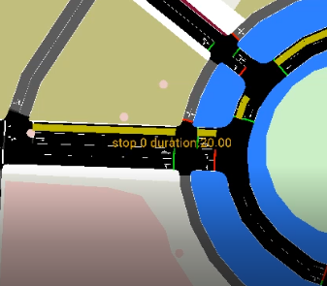
94.000
if(timeSeconds==90.0) {
String senderEdgeID ="160253722#1";
Vehicle.changeTarget("flow0.0", senderEdgeID));
new SumoStopFlags(false, false, false, false, false);
double duration = 20.0;
Vehicle.setStop("flow0.0", senderEdgeID, 1.0, (byte)1, duration, sf_send));
// 計算到達sender的travelTime
// 通知sender
}

Slide 38
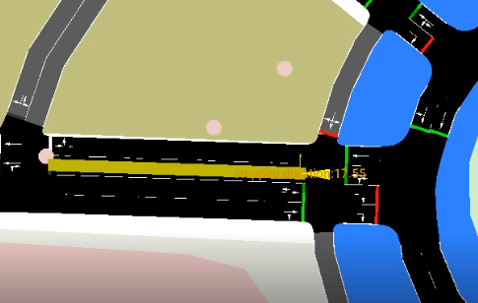
Vehicle stoped at position 1.0 of the lane in 190.0s
Vehicle.setStop
("flow0.0", senderEdgeID, 1.0, (byte)1,
duration, SumoStopFlags));

